Slide 1
Chatbot for TAAM’s Customers

Slide 2
Solution benefits
Responses for frequently asked questions about product, feature, model from customers can be automated
Reduces burden on support

Slide 3
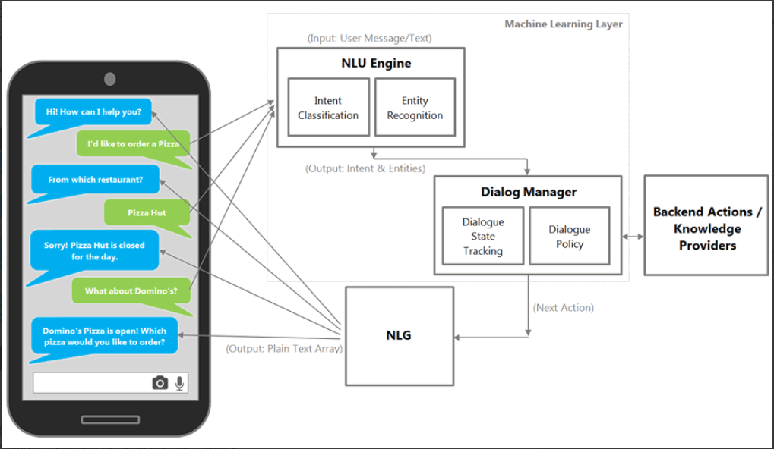
Chatbot architecture

Slide 4
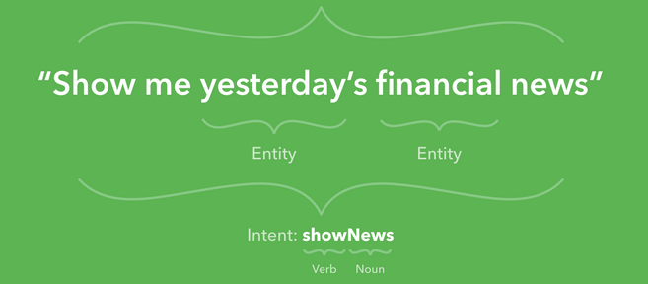
Chatbot architecture – NLU Engine – {Intent and Entity}

Slide 5
Chatbot architecture – Dialogue Manager
Dialogue State Tracker
Maintains Previous Conversation State
Checks if conversation needs to be updated based on intent
Consults Dialogue Policy for further action
Dialogue Policy
- High level framework that trains the chatbot

Slide 6
Chatbot Architecture – Backend Knowledge Providers
Knowledge Management System
CRM
Structured Data
Unstructured Data

Slide 7
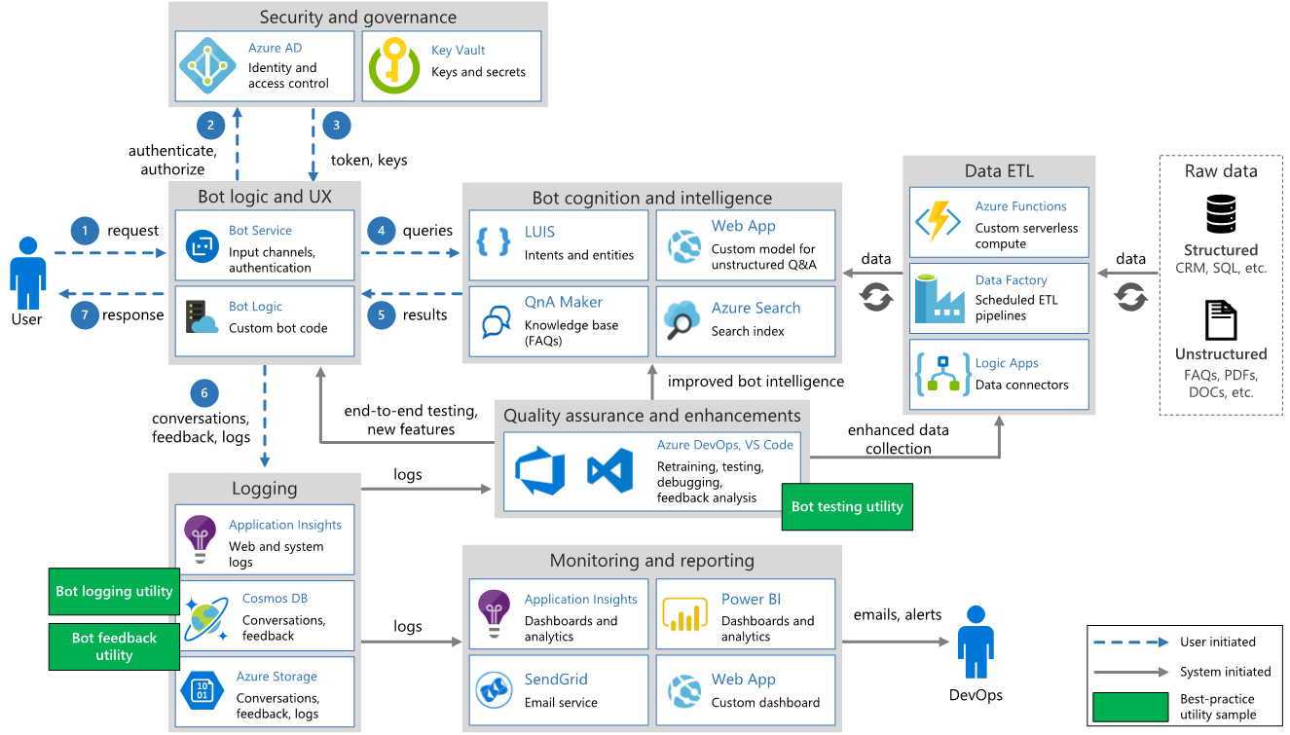
Architecture of Proposed Bot Framework – MS Bot FRAmework

